Slide 1

MOVIE INDUSTRY ANALYSIS
DATA-DRIVEN STUDY OF KENYA’S EXCHANGE RATE DYNAMICS
UNDERSTANDING THE FORCES SHAPING KENYA’S CURRENCY VALUATIONS
Prepared by: Brenda K., Saron W., Brenda C., Daniel O., Mark C.

Slide 2
Overview
This presentation is divided into 5:
Business Understanding
Data Understanding
Data Analysis
Modeling
Conclusions and Recommendation

Slide 3
Business Understanding

Slide 4
We used data from various sources specifically key macroeconomic indicators as well as other indicators such as the exchange rate(target variable), interest rates such as banking(deposit, lending, overdraft, savings), and central bank rates(T-bills, Cash Reserve, Inter-bank Rates).
Due to the variation in timeline for the data sources, some daily, monthly, and yearly, we worked using averages and came up with 4 different data sets. Our primary one is the monthly dataset(with some repeat values), and also the yearly average(with no repeat values).
For our initial analysis, we shall work with the monthly dataset and then proceed with the yearly average one especially for modelling

Slide 5
Objectives
To conduct exploratory data analysis (EDA) on the USD/KES exchange rate from 2003 to 2023, identifying major trends, seasonal patterns, and conducting time series decomposition.
To develop and compare time series forecasting models to predict exchange rate movements in 2024 and validate forecasts against actual 2024 data.
To apply supervised learning techniques to detect distinct volatility or trend regimes in USD/KES exchange rate data.
To determine the macroeconomic indicators with the greatest influence on exchange rate behavior.

Slide 6
Methods
The methods used in the analysis are as follows:
Data Collection
Exploratory Data Analysis
Data Cleaning
Data visualization
Statistical Analysis - correlations
Modeling

Slide 7
Data Understanding

Slide 8
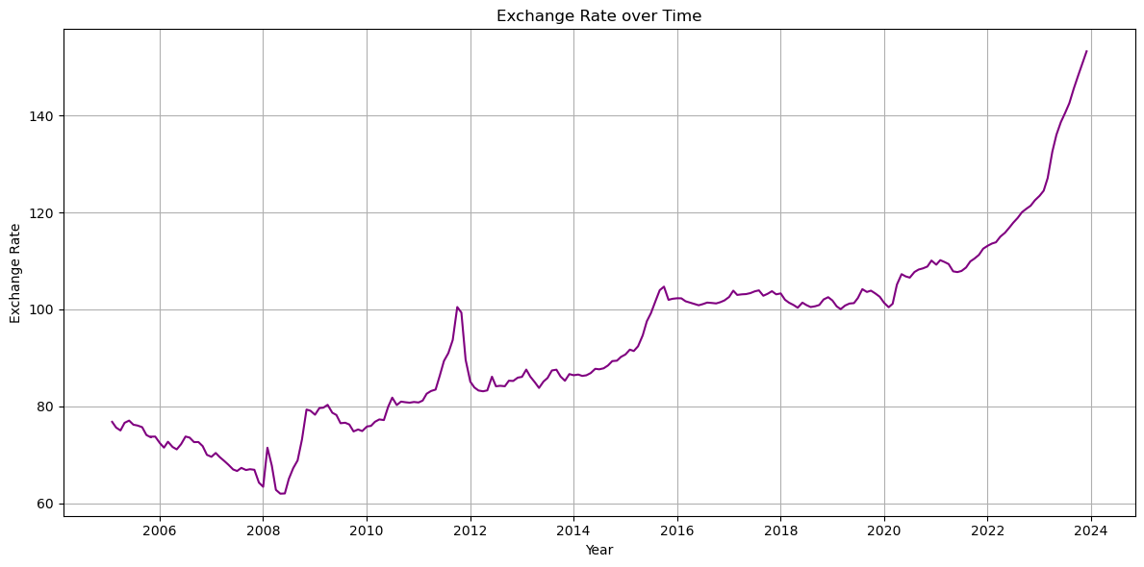
From 2005 to 2008, the Kenyan Shilling steadily strengthened but weakened sharply during the 2008–2009 and 2011–2012 election-related tensions.
A significant depreciation occurred from 2022 to 2024, likely due to increased government borrowing and looming debt repayments.

Slide 9
Data Analysis

Slide 10
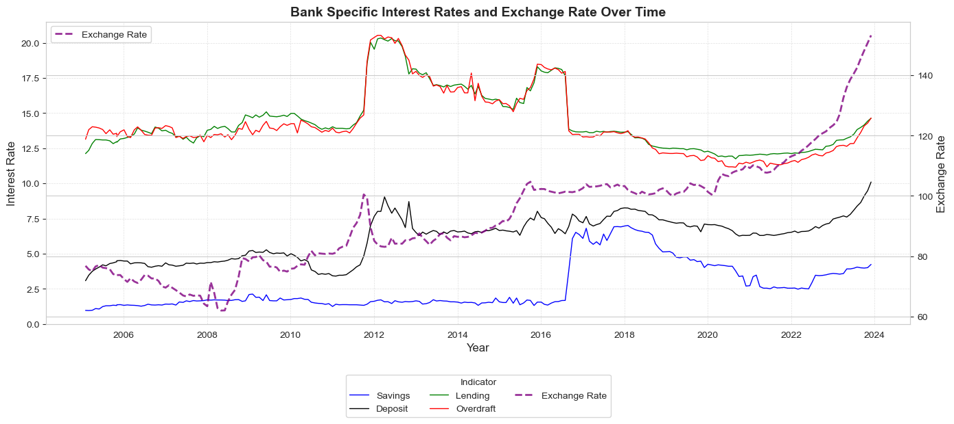
Banking Rates vs Exchange Rate
The deposit interast rate tends to follow closely the exchange rate, we can attribute this to the fact that money is weakening, less people are investing and as such due to the low demand for fixed deposits, banks are forced to increase the interest rate to attract more money.
Lending and Overdraft have very little effect on the exchange rate.

Slide 11
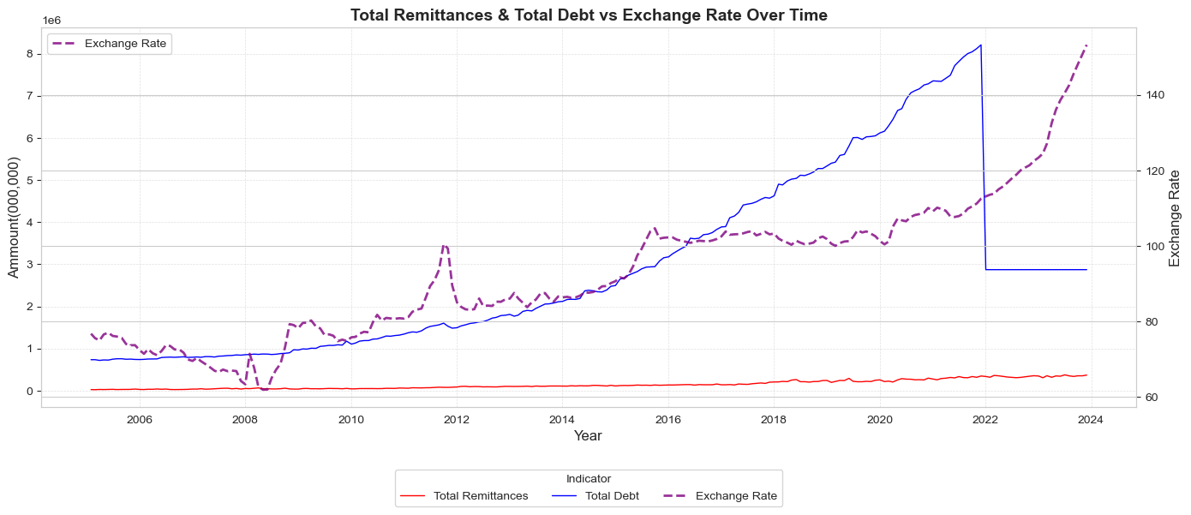
Total Debt and Total Remittances vs Exchange rate
1. The plot evaluates how external support and national debt may influence currency strength or depreciation.
2. The country may have been using external debt to cushion the currency, however as soon as the repayment matured and Kenya made it the currency greatly weakened due to the currency outflow.

Slide 12
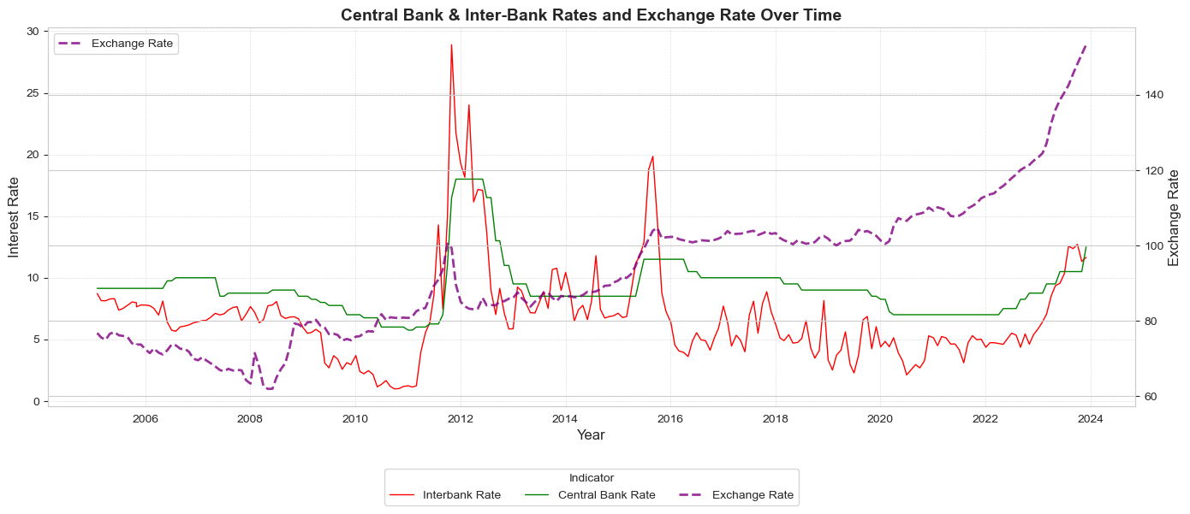
Interbank and Central Bank Interest rates vs Exchange rate
This plot compares Central Bank Rate and Interbank Rate with the exchange rate over time, helping evaluate how monetary policy and market liquidity conditions influence currency value.

Slide 13
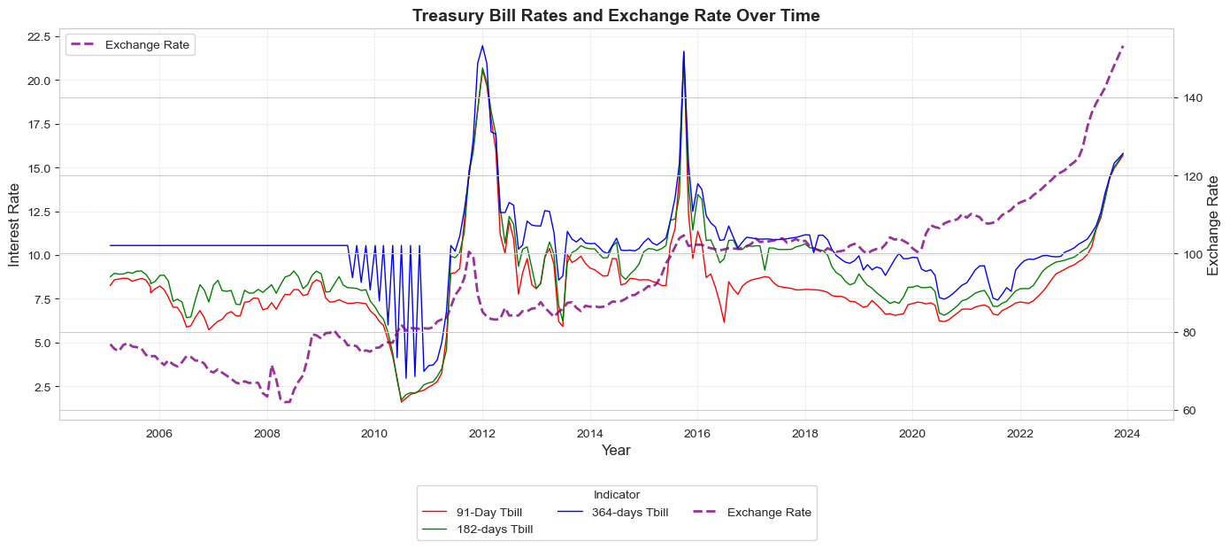
Treasury Bills (91-Day, 182-Days, 364-Days) Rate vs Exchange rate
This plot compares short-term government interest rates (T-bills) with the exchange rate to show how market interest rates may influence or react to currency movements, helping understand investor behavior and macroeconomic conditions.

Slide 14
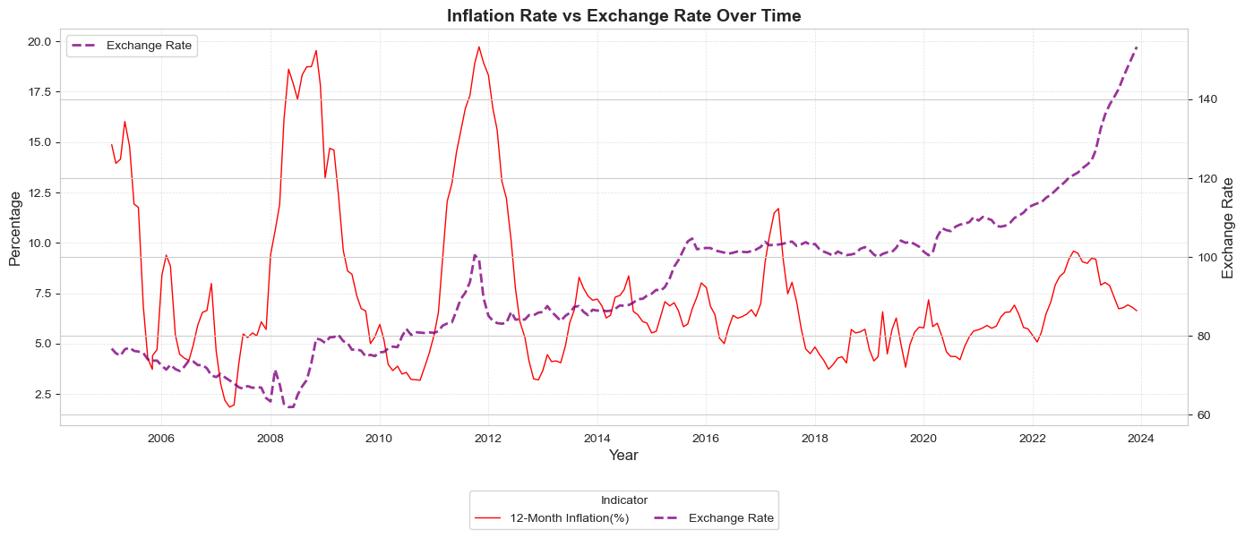
Inflation Rate vs Exchange rate
Inflation has very little effect on exchange rate. However, significant similar spikes are seen around the election periods of 2012, 2017.

Slide 15
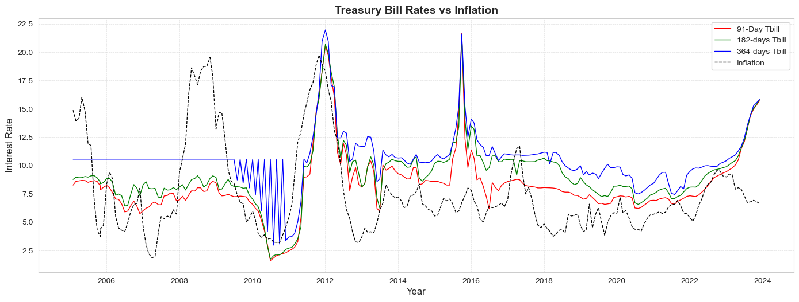
Treasury bills vs Inflation
Close relation ship between inflation and Treasury bills, and how they are used a fiscal tool to control the inflation rate. However, we see that the influences are not so significantly strong hence why treasury bills are used in conjunction with other methods to stabilize inflation.

Slide 16
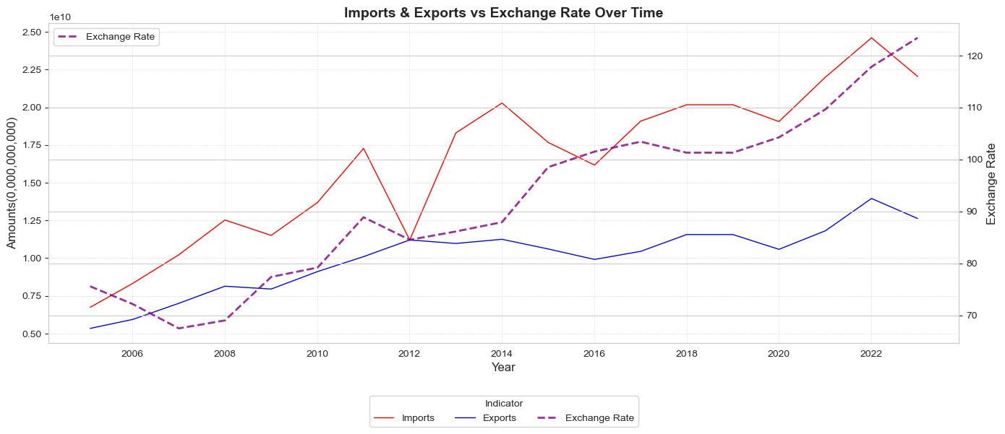
Imports and Exports vs Exchange Rate
The plot helps assess how trade performance especially trade imbalances may affect currency strength, showing whether higher imports or exports correspond with currency depreciation or appreciation.

Slide 17
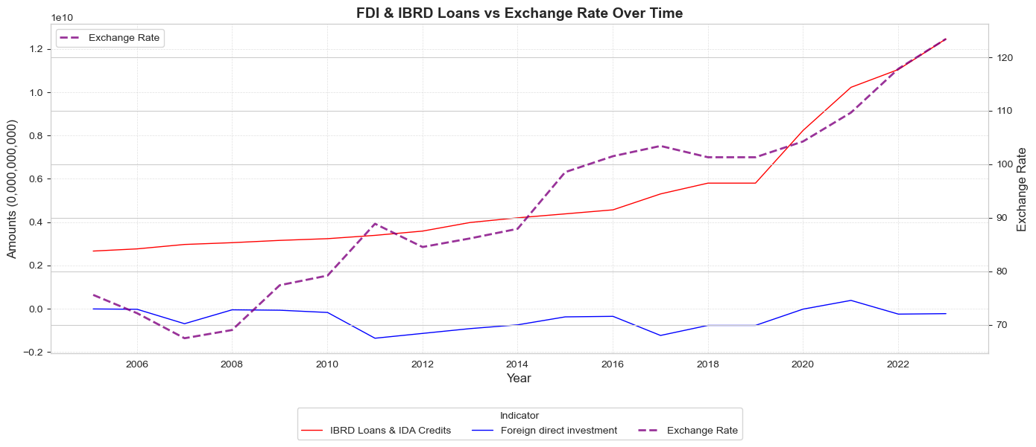
Foreign Direct Investment and IBRD loans and IDA credits (DOD, current US$) vs Exchange rate
Comparison of FDI and external loans (IBRD/IDA) with the exchange rate over time, offering insights into how capital inflows and external borrowing affect currency strength and economic confidence.

Slide 18
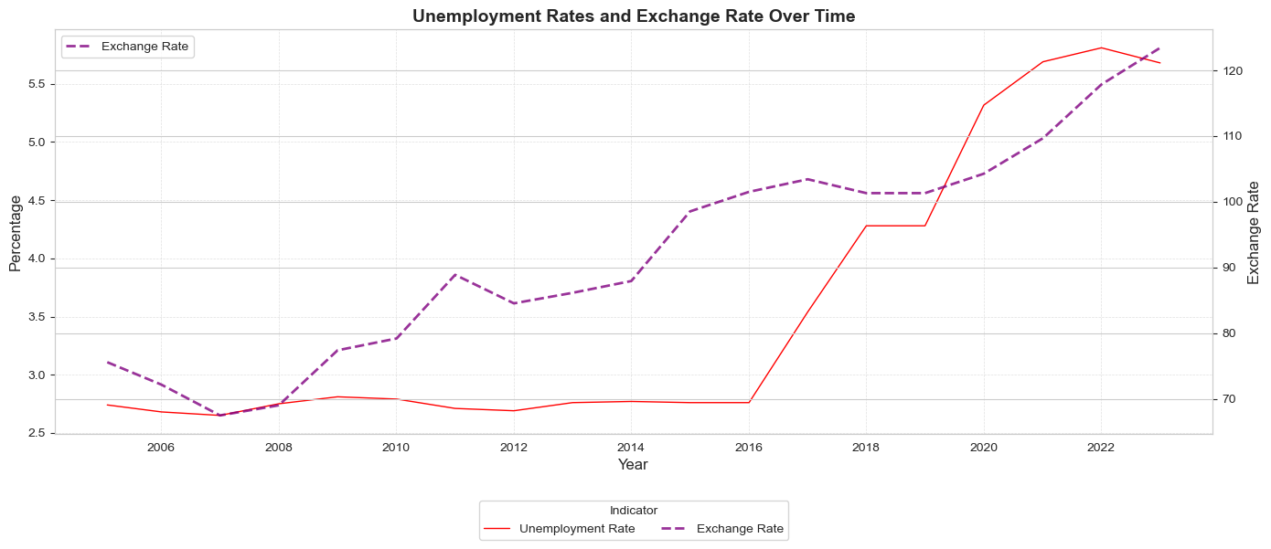
Unemployment Rate vs Exchange Rate
The highlights between labor market conditions and currency value, showing how domestic economic performance can influence the exchange rate.

Slide 19
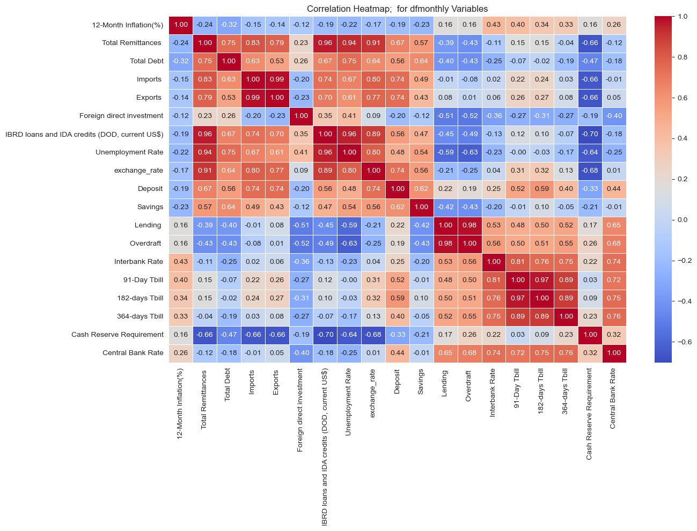
Cross Correlation for all the variables

Slide 20
Modeling

Slide 21
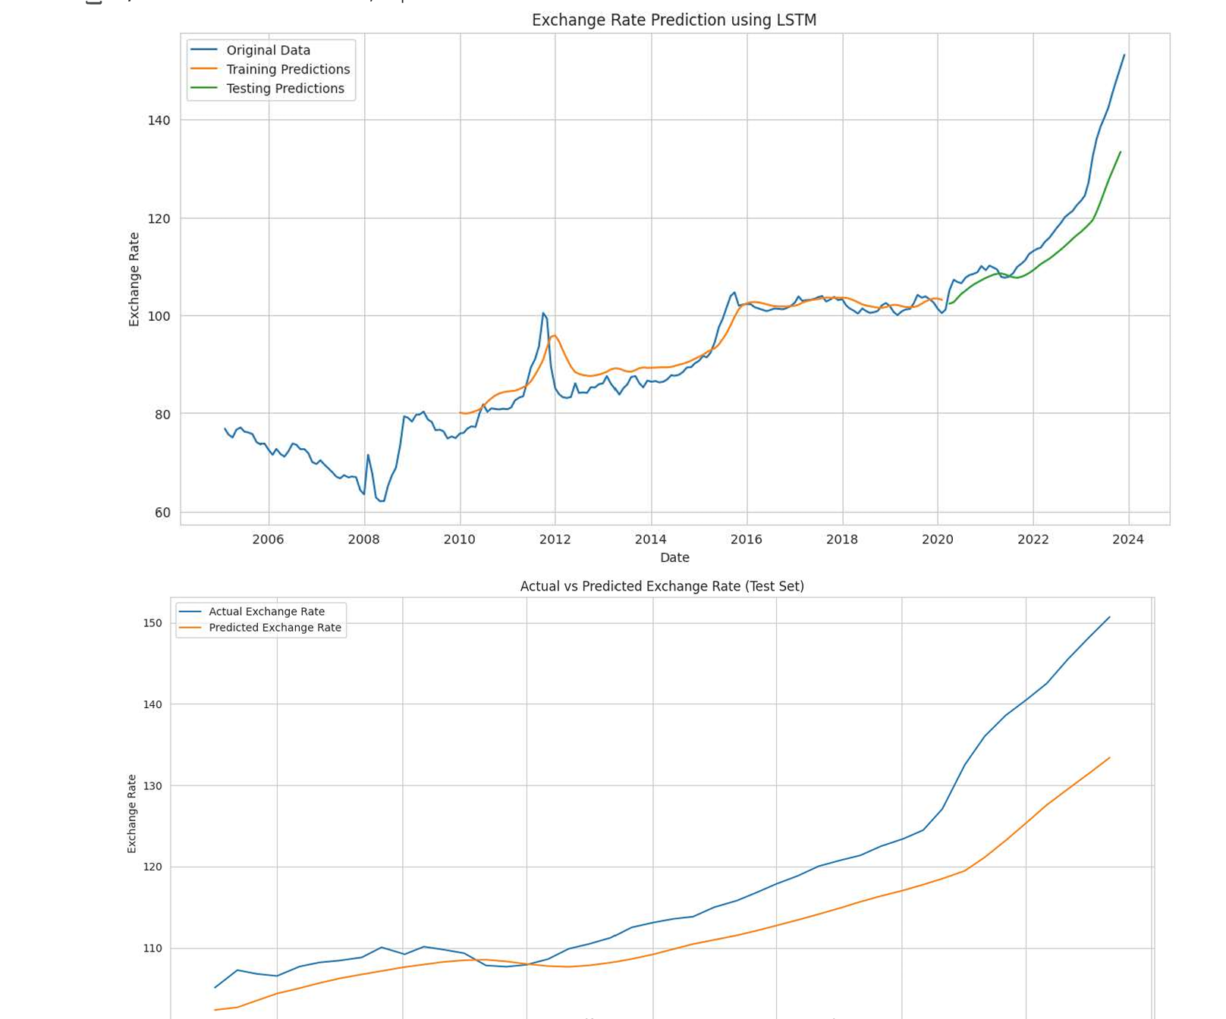
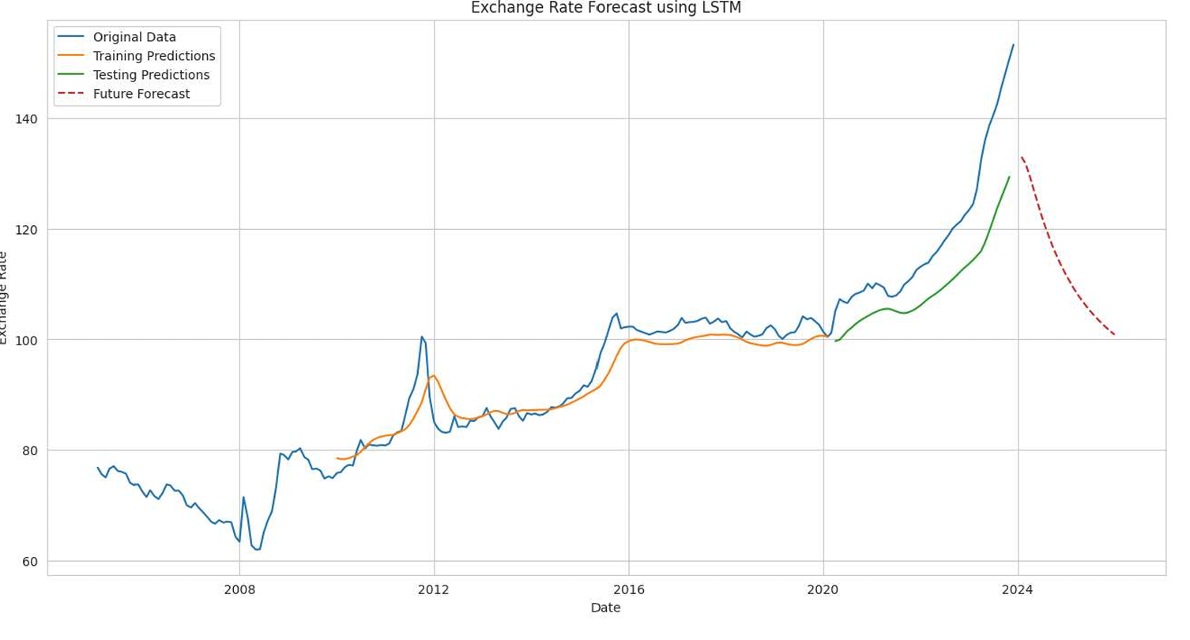
LSTM Model
The LSTM model captures the overall trend of the USD/KES exchange rate well but underestimates the sharp rise in recent years.
Training predictions closely follow historical data, while test predictions lag behind actual values during the 2022–2023 surge.
This suggests the model struggles with sudden, steep changes in the exchange rate.

Slide 22
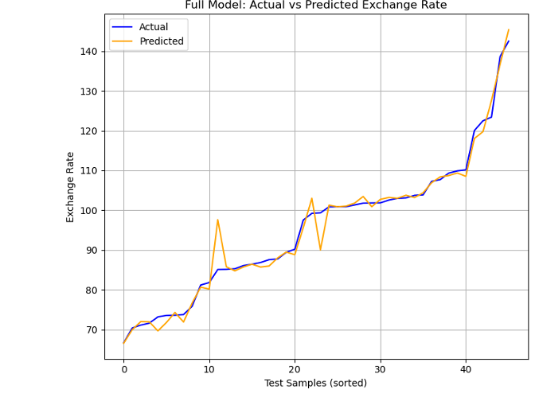
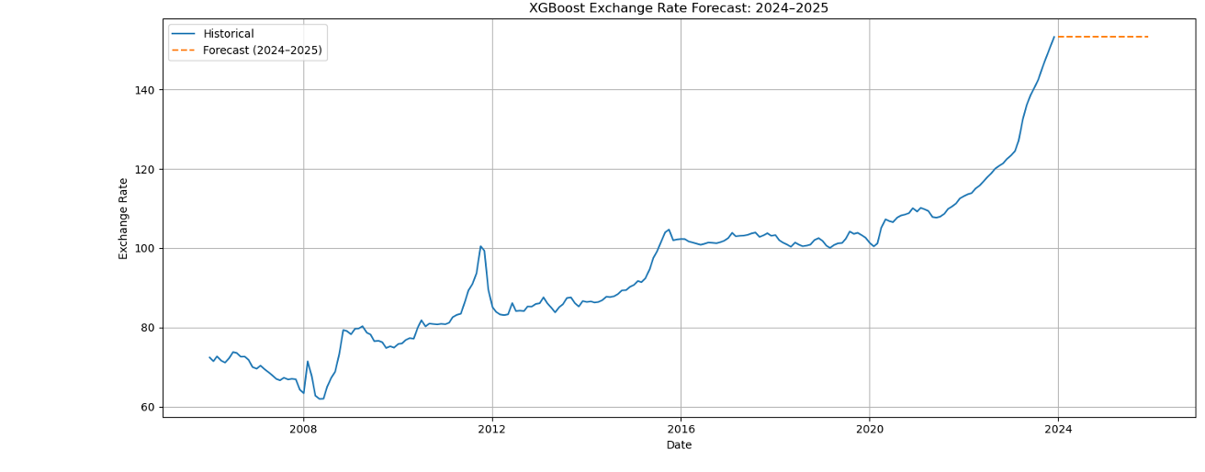
Xgboost Model

Slide 23
Summary of all used models
Model Metric | ARIMA | EXPONENTIAL SMOOTHING | PROPHET | MOVING AVERAGE | LSTM | XG BOOST
RMSE | 22.360 | 1.644 | 2.614 | 20.572 | 6.051 | 2.737
MSE | 486.684 | 2.703 | 6.830 | 423.223 | 36.612 | 7.490
MAE | 17.491 | 1.002 | 2.007 | 17.893 | 4.503 | 1.538
MAPE | 14.040 | 1.149% | 2.200% | 12.455% | 3.540% | 1.620%
R² Score | -1.766 | 0.992 | 0.979 | -3.510 | 0.768 | 0.974

Slide 24
Conclusion
Features
From our exploratory analysis, we came to the conclusion that the following features have the most influence on/are influenced by the exchange rate;
Imports & Exports
IBRD Loans & IDA Credits
Unemployment
Bank Deposit Rate
Savings
Total Debt
Total Remittances
For a future and ongoing analysis after this one, these would be the key features to consider in the analysis.

Slide 25
Conclusion
Models
From the below table, we can see very mixed reactions from the metrics and forecasted values;
Model Date | ARIMA | EXPONENTIAL SMOOTHING | PROPHET | MOVING AVERAGE | LSTM | XG BOOST | ACTUAL (CLOSING)
Dec – 2023 |  | 155.13 | 144.60 | 154.95 |  |  | 154.09
Jan – 2024 | 254.87 | 157.01 | 147.06 | 155.44 | 141.23 |  | 159.69
Feb – 2024 | 356.63 | 158.90 | 147.06 | 155.47 | 141.32 |  | 151.84
Mar – 2024 | 458.53 | 160.78 | 148.29 | 155.60 | 140.67 |  | 137.35
Apr – 2024 | 560.56 | 162.67 | 148.54 | 155.56 | 139.72 |  | 131.57
May – 2024 | 662.72 | 164.55 | 148.36 | 155.54 | 138.69 |  | 131.69
Jun – 2024 | 765.02 | 166.44 | 169.22 | 155.40 | 137.67 |  | 129.36
July – 2024 | 867.45 | 168.32 | 151.92 | 155.39 | 136.70 |  | 129.87
Aug – 2024 | 970.02 | 170.21 | 152.06 | 155.37 | 135.80 |  | 129.32
Sep – 2024 | 1072.71 | 172.09 | 171.16 | 155.27 | 134.95 |  | 129.20
Oct – 2024 | 1175.55 | 173.98 | 154.02 | 155.14 | 134.16 |  | 129.20
Nov – 2024 | 1278.51 | 175.86 | 156.24 | 154.96 | 133.42 |  | 129.40
Dec – 2024 | 1381.61 |  | 173.63 |  | 132.72 |  | 129.36

Slide 26
Recommendation
Integrate continuous EDA and decomposition tools into the national financial reporting system to monitor seasonal or structural shifts in currency dynamics.
Adopt the best-performing forecasting model (e.g., Exponential Smoothing or ARIMA) for regular use by financial institutions and central bank analysts to enhance forecasting precision.
Use machine learning–based regime detection to inform risk-adjusted investment strategies and enhance the timing of monetary policy interventions.
Prioritize identified key indicators (e.g., inflation, interest rates) in macroeconomic policy targeting, exchange rate management, and central bank communications.

Slide 27
The end!

Slide 28

Any Questions?

